Slide 1
CSci 3081W: Program Design and Development
Week 4 – Inheritance, Polymorphism, SOLID (and other) design principles

Slide 2
C vs C++ - The Key Difference
C is procedural; C++ supports Object-Oriented Programming (OOP)
OOP enables encapsulation, inheritance, and polymorphism
Why OOP matters: reusability, maintainability, and abstraction
 | Encapsulation | Inheritance | Polymorphism
C | No | No | No
C++ | Yes | Yes | Yes

Slide 3
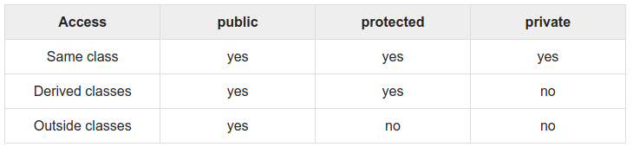
Access Specifier Review

Slide 4
Introduction to Inheritance
Inheritance allows a class to derive from another
Promotes code reuse and hierarchy modeling
class derived : public base {
};

Slide 5
Inheritance Syntax in C++
class Derived : public Base {...};
class Derived : private Base {...};
class Derived : protected Base {...};
Use public inheritance

Slide 6
Public Inheritance
class Base {
public:
int publicVar = 1;
protected:
int protectedVar = 2;
private:
int privateVar = 3; // Not inherited
public:
void showPublic() { std::cout << "Base Public\n"; }
protected:
void showProtected() { std::cout << "Base Protected\n"; }
private:
void showPrivate() { std::cout << "Base Private\n"; }
};

Slide 7
Public Inheritance
class DerivedPublic : public Base {
public:
void accessMembers() {
std::cout << "PublicVar: " << publicVar << "\n"; // Allowed (remains public)
std::cout << "ProtectedVar: " << protectedVar << "\n"; // Allowed (remains protected)
// std::cout << privateVar; // Error: private members are NOT inherited
}
void useBaseFunctions() {
showPublic(); // Allowed (remains public)
showProtected(); // Allowed (remains protected)
// showPrivate(); // Error: private members are NOT inherited
}
};

Slide 8
Public Inheritance
int main() {
DerivedPublic obj;
obj.showPublic(); // Allowed (public in DerivedPublic)
// obj.showProtected(); // Error: protected in DerivedPublic
obj.accessMembers();
}
Public members remain public in the derived class.
Protected members remain protected.
Private members are NOT inherited.

Slide 9
Public vs. Protected vs. Private Inheritance
Base Class Member | Public Inheritance | Protected Inheritance | Private Inheritance
public | Public | Protected | Private
protected | Protected | Protected | Private
private | Not Inherited | Not Inherited | Not Inherited

Slide 10
Multiple Inheritance
class Derived : public Base1, public Base2 {...};
Pros of multiple inheritance
Code Reusability
A derived class can reuse functionality from multiple base classes, reducing redundant code.
Example: If FlyingAnimal and SwimmingAnimal exist, a Duck can inherit from both.
Expressive Modeling
Models real-world relationships more accurately in some cases.
Example: A Smartphone can inherit from both Camera and Phone.
Avoids Redefining Common Functionality
Instead of implementing the same methods in multiple derived classes, they can be inherited.

Slide 11
Multiple Inheritance
class Derived : public Base1, public Base2 {...};
Cons of multiple inheritance
The Diamond Problem
Issue: If two base classes inherit from the same grandparent, and a derived class inherits from both, ambiguity arises over which grandparent's member should be used.
Solution: Use virtual inheritance to ensure only one copy of the grandparent exists.
class A {
public:
void show() { std::cout << "A::show\n"; }
};
class B : virtual public A {};
class C : virtual public A {};
class D : public B, public C {};
int main() {
D obj;
obj.show(); // No ambiguity due to virtual inheritance
}

Slide 12
Multiple Inheritance
class Derived : public Base1, public Base2 {...};
Cons of multiple inheritance
Increased Complexity
Debugging and understanding code becomes harder when multiple base classes interact.
Potential Name Conflicts
If two base classes have a function with the same name, the derived class must disambiguate which one to use.
Increased Memory Overhead
Multiple base class objects may increase memory consumption.
Harder Maintenance
Changes in one base class may have unintended effects on derived classes.

Slide 13
Multiple Inheritance
class Derived : public Base1, public Base2 {...};
When to use multiple inheritance?
Use when classes have distinct, non-overlapping responsibilities
Avoid when a deep hierarchy or composition provides a simpler solution

Slide 14
Polymorphism and Virtual Functions
Polymorphism: Ability to call derived class methods through a base class pointer.
Dynamic Dispatch: The correct method is determined at runtime.
virtual Keyword: Enables runtime method overriding.
override Keyword: Ensures a method in a derived class correctly overrides a virtual function in the base class.

Slide 15
Polymorphism and Virtual Functions
class Base {
public:
virtual void show() { std::cout << "Base"; }
};
class Derived : public Base {
public:
void show() override { std::cout << "Derived"; }
};
int main() {
Base* obj = new Derived();
obj->show(); // Outputs: "Derived"
delete obj;
}

Slide 16
Abstract Classes and Pure Virtual Functions
Abstract Class: A class with at least one pure virtual function. Cannot be instantiated, must be inherited and implemented.
class Shape {
public:
virtual float getArea() = 0; // Pure virtual function
};
class Circle : public Shape {
public:
Circle(float r) : radius(r) {}
void float getArea() override { return 3.1415*radius*radius; }
private:
float radius;
};

Slide 17


Interfaces
Interface: A class with all pure virtual functions. Cannot be instantiated, must be realized and implemented.
Common practice to start Interface classes with an “I”. i.e. IEntity
Classes do not inherit from interfaces. Classes realize from interfaces.
Inheritance arrow in UML
Realization arrow in UML

Slide 18
Composition vs. Inheritance
When Not to Use Inheritance
Inheritance increases tight coupling
Sometimes Composition is better (HAS-A instead of IS-A)
Conceptual Example
Bad example: A Car inheriting from Engine
Good example: A Car has an Engine
class Car {
public:
Engine* engine;
Car(...) {...}
...
};
class Engine {
public:
Engine(...) {...}
...
};

Slide 19
SOLID Design Principles in C++
The SOLID principles are five key principles of object-oriented design that improve code maintainability, scalability, and reusability.
Single Responsibility Principle (SRP)
Open/Closed Principle (OCP)
Liskov Substitution Principle (LSP)
Interface Segregation Principle (ISP)
Dependency Inversion Principle (DIP)

Slide 20
Single Responsibility Principle (SRP)
Definition: A class should have only one reason to change, meaning it should have a single responsibility.

Slide 21
Single Responsibility Principle (SRP)
Bad Example (violation of SRP):
class Report {
public:
void generateAndPrint() {
std::string reportData = "Report Data";
std::cout << "Printing: " << reportData;
}
};
Why?
Issue: The Report class has two responsibilities: generating and printing.

Slide 22
Single Responsibility Principle (SRP)
Good Example:
class Report {
public:
std::string generate() {
return "Report Data";
}
};
class ReportPrinter {
public:
void print(const std::string& reportData) {
std::cout << "Printing: " << reportData;
}
};
Why?
Report handles data generation, and ReportPrinter handles printing, ensuring separation of concerns.

Slide 23
Open/Closed Principle (OCP)
Definition: A class should be open for extension but closed for modification.

Slide 24
Open/Closed Principle (OCP)
Bad Example (violation of OCP):
class Shape {
public:
enum Type { CIRCLE, RECTANGLE };
Type type;
double radius, width, height;
};
class AreaCalculator {
public:
double calculateArea(const Shape& shape) {
if (shape.type == Shape::CIRCLE)
return 3.14 * shape.radius * shape.radius;
else if (shape.type == Shape::RECTANGLE)
return shape.width * shape.height;
return 0;
}
};
Why?
Issue: Every new shape requires modifying AreaCalculator, violating OCP.

Slide 25
Open/Closed Principle (OCP)
Good Example:
class Shape {
public:
virtual double area() const = 0;
virtual ~Shape() = default;
};
class Circle : public Shape {
private:
double radius;
public:
Circle(double r) : radius(r) {}
double area() const override { return 3.14 * radius * radius; }
};
Why?
The Shape class can be extended without modifying existing code.

Slide 26
Liskov Substitution Principle (LSP)
Definition: Subtypes must be substitutable for their base types without altering program behavior.

Slide 27
Liskov Substitution Principle (LSP)
Bad Example (violation of LSP):
class Bird {
public:
virtual void fly() { std::cout << "Flying..."; }
};
class Penguin : public Bird {
public:
void fly() override { throw std::logic_error("Penguins can't fly"); }
};
Why?
Issue: Penguin violates LSP because it changes expected behavior.

Slide 28
Liskov Substitution Principle (LSP)
Good Example:
class Bird {
public:
virtual void fly() const { std::cout << "Flying..."; }
virtual ~Bird() = default;
};
class Sparrow : public Bird {};
Why?
Sparrow can be used anywhere a Bird is expected without issue.

Slide 29
Interface Segregation Principle (ISP)
Definition: Clients should not be forced to depend on interfaces they do not use.

Slide 30
Interface Segregation Principle (ISP)
Bad Example (violation of ISP):
class Machine {
public:
virtual void print() = 0;
virtual void scan() = 0;
};
class SimplePrinter : public Machine {
public:
void print() override { std::cout << "Printing..."; }
void scan() override {} // Useless method for this class
};
Why? Issue: SimplePrinter is forced to implement scan() even though it doesn't need it.

Slide 31
Interface Segregation Principle (ISP)
Good Example:
class Printer {
public:
virtual void print() = 0;
virtual ~Printer() = default;
};
class Scanner {
public:
virtual void scan() = 0;
virtual ~Scanner() = default;
};
class MultiFunctionPrinter : public Printer, public Scanner {
public:
void print() override { std::cout << "Printing..."; }
void scan() override { std::cout << "Scanning..."; }
};
Why? Separate interfaces for Printer and Scanner prevent forcing unnecessary functionality.

Slide 32
Dependency Inversion Principle (DIP)
Definition: High-level modules should not depend on low-level modules; both should depend on abstractions.

Slide 33
Dependency Inversion Principle (DIP)
Bad Example (violation of DIP):
class PetrolEngine {
public:
void start() { std::cout << "Petrol Engine Starting..."; }
};
class Car {
private:
PetrolEngine engine;
public:
void start() { engine.start(); }
};
Why? Issue: Car is tightly coupled with PetrolEngine, making it hard to switch to a different engine type.

Slide 34
Dependency Inversion Principle (DIP)
Good Example:
class Engine {
public:
virtual void start() = 0;
virtual ~Engine() = default;
};
class PetrolEngine : public Engine {
public:
void start() override { std::cout << "Petrol Engine Starting..."; }
};
class Car {
private:
Engine& engine;
public:
Car(Engine& eng) : engine(eng) {}
void start() { engine.start(); }
};
Why? Car depends on an abstraction (Engine) rather than a concrete class.

Slide 35
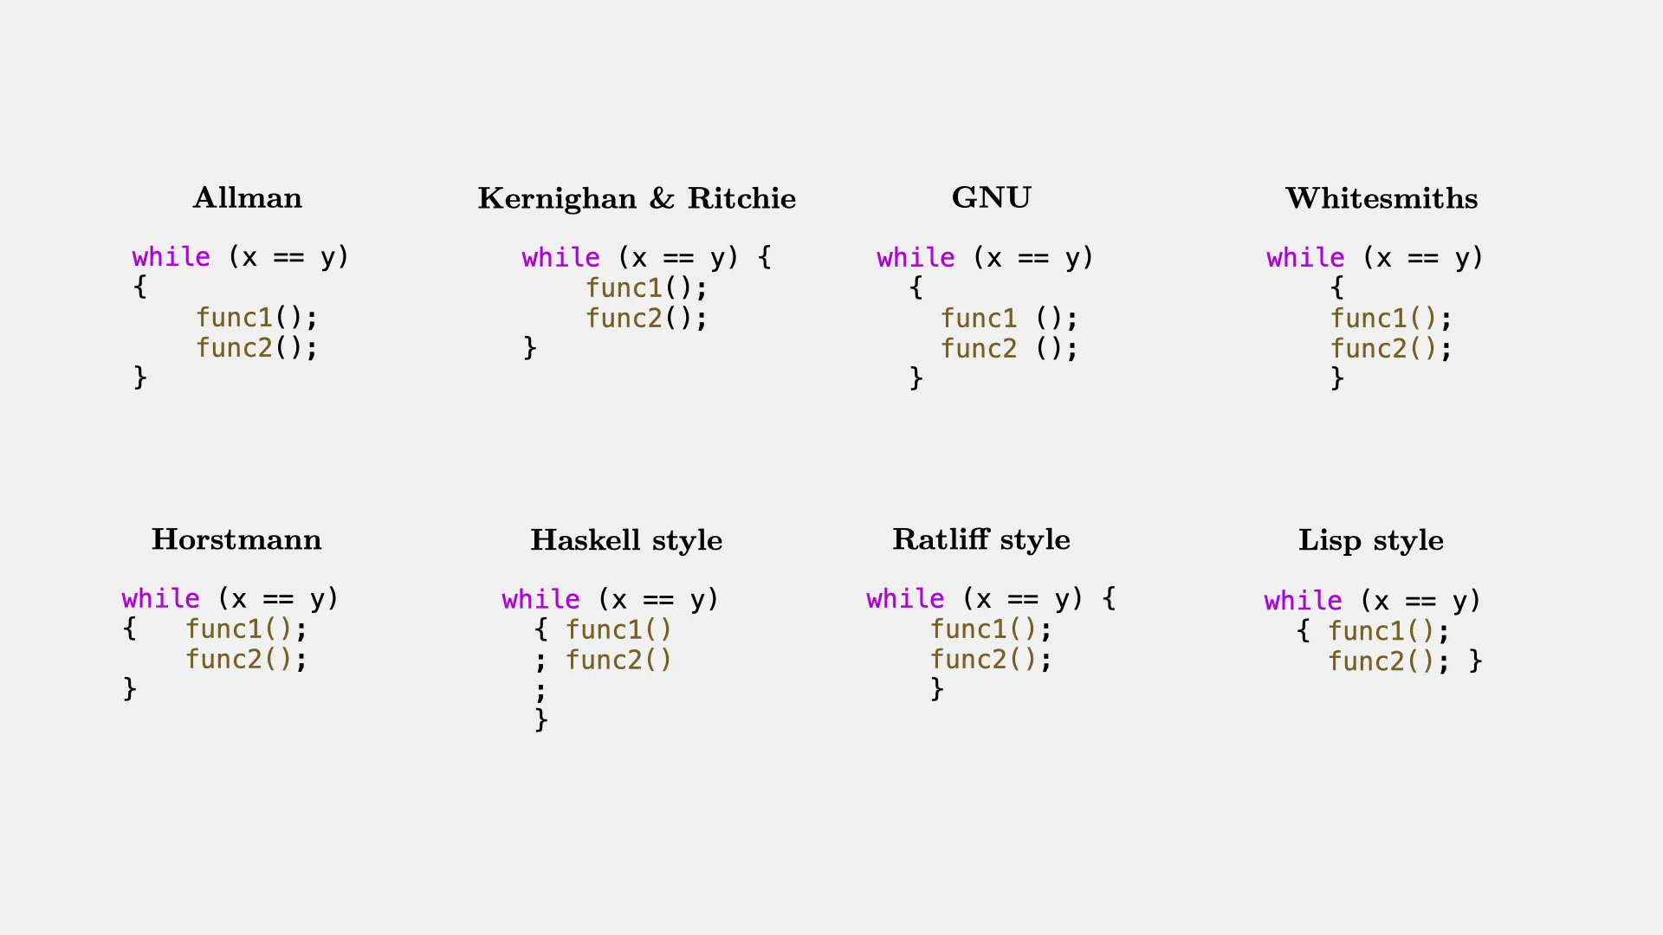
Code Style
Best

Slide 36
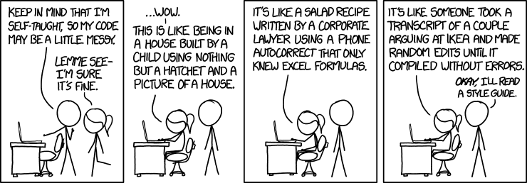
Code Style

Slide 37
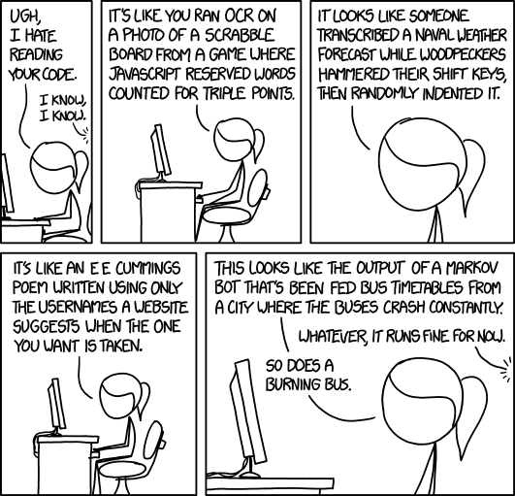
Code Style

Slide 38
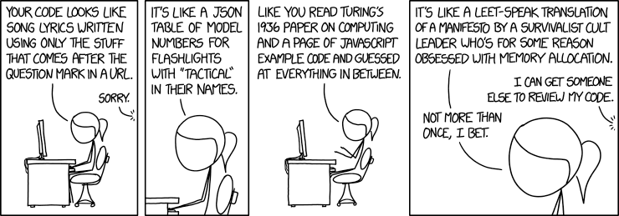
Code Style

Slide 39
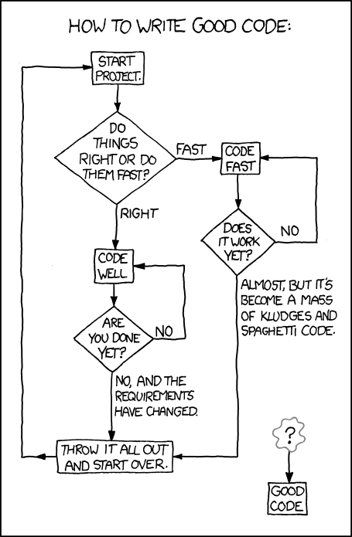
Code Style

Slide 40
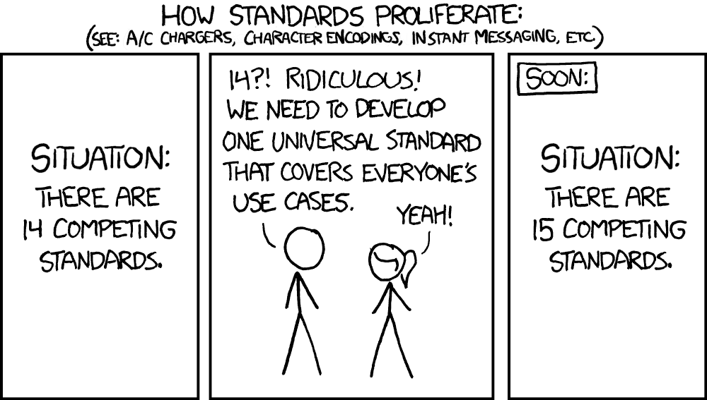
Code Style

